Slide 1
Project Presentation of FSE Project
On
Tour Et. – Tour and Travel Website
Saksham Dutta (2210992220)
Saket (2210992217)
Saksham Gupta(2210992222)
Samar Satnam Singh (2210992234)
Supervised By
Mr. Rahul
Department of Computer Science and Engineering,
Chitkara University, Punjab

Slide 2

Introduction
Welcome to Tour Et. , your go-to platform for effortless travel planning. We offer a wide range of destinations, customized travel packages, and seamless booking options, ensuring a stress-free and memorable travel experience for every journey.
2

Slide 3
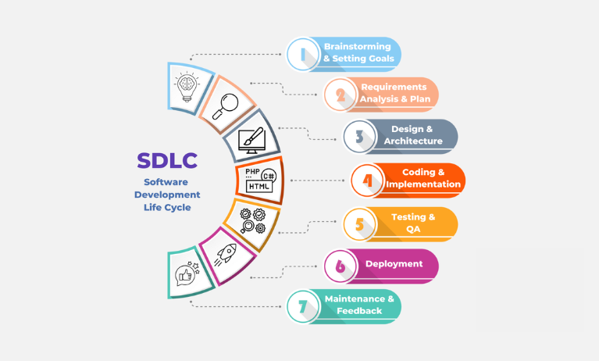
SDLC MODEL

Slide 4



TECHNICAL DETAILS
HTML:
Markup language for creating the structure of web pages.
Utilizes elements like <div>, <p>, <img> to organize content.
Forms for user input, with various input types like text, password, etc.
Semantics for accessibility and SEO.
TAILWIND CSS:
A utility-first CSS framework for styling HTML elements.
Simplifies layout design with classes for the box model: content, padding, border, and margin
Provides utility classes for positioning, display, flexbox, and grid layouts.
Enables responsive design through media query utilities.
REACTJS:
Allows dynamic rendering of HTML content based on real-time data.
Facilitates reusable components like headers, footers, and forms.
Supports conditional rendering to tailor content based on user roles or data.
Seamlessly integrates form handling for actions like login and data submissions.
Efficiently loops through arrays to render dynamic content such as notices, events, or appointments.

Slide 5



TECHNICAL DETAILS
Backend
MongoDB:
NoSQL database designed for handling large volumes of data.
Uses flexible, JSON-like documents to store data.
Supports dynamic schemas, allowing easy updates to data structure.
Provides horizontal scaling for managing distributed data.
Facilitates fast queries and indexing for efficient data retrieval.
Express:
Express is a minimal and flexible Node.js web application framework
that provides a robust set of features for web and mobile applications.
Express is a lightweight and flexible routing framework with minimal
core features meant to be augmented through the use of Express middleware modules.
Postman:
Postman is a global software company that offers an API platform for developers to design, build, test, and collaborate on APIs.

Slide 6
Features
Overview: A modern tourist website designed for users to easily explore , easy to search, and book their favourite and affordable place.
Key Features:
Easy-to-use interface
Responsive design for all devices
Saved by relevant category
Easily defined
Search through relevant means
Able to explore

Slide 7

Target Audience
Who is this for?
Everyone
Goal: Able to make everyone travel through safe , secure and affordable means such that they can be comfortable wherever they go.

Slide 8
User-Friendly Interface
Drag-and-Drop Functionality: Easily searchable places to go
to
Rich Text Editor: Built-in tools for to places they want to go and according to what they can afford.
Intuitive Navigation: Simple menus for easy access to different sections of the website.

Slide 9
Languages
MongoDB
A NoSQL database that stores data in flexible, JSON-like documents, perfect for content-rich applications like blogs.
Express.js
A minimal and flexible Node.js web application framework that provides a robust set of features for web and mobile applications.
React
A powerful JavaScript library for building user interfaces, enabling the creation of dynamic, responsive, and interactive travel experiences.
Node.js
A JavaScript runtime built on Chrome's V8 JavaScript engine, allowing server-side scripting and efficient data handling.

Slide 10
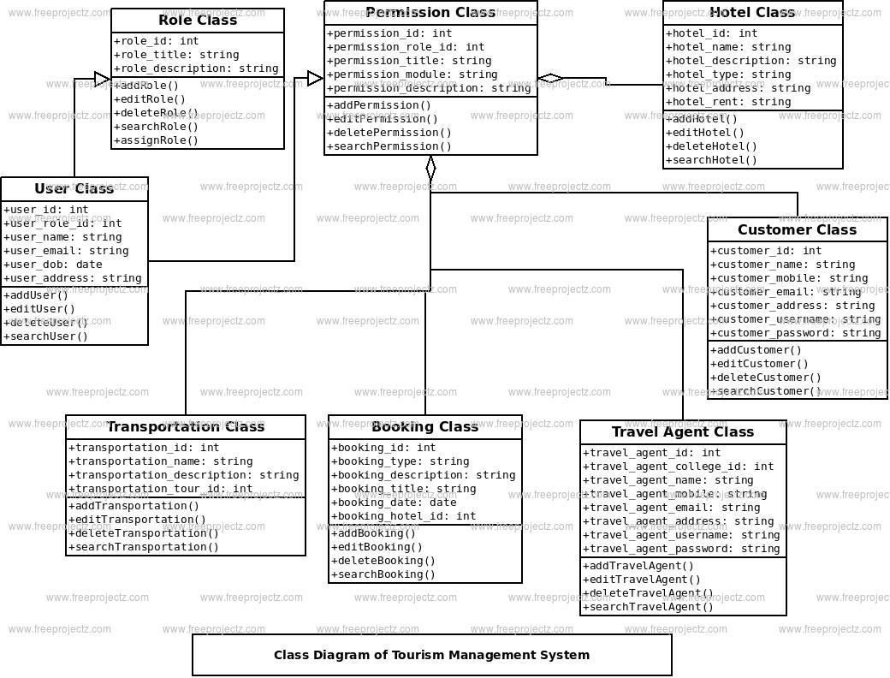
ER Diagram

Slide 11

CONCLUSION
In conclusion, our tour and travel website is designed to offer seamless travel experiences, whether you're looking for a relaxing vacation, an adventure getaway, or a cultural exploration. With user-friendly navigation, a wide range of destination options, real-time bookings, and personalized recommendations, we are committed to making travel planning easy and enjoyable. Our platform not only helps you discover the best travel packages but also ensures that every trip is memorable and hassle-free.
Key Highlights:
Wide Range of Destinations: Explore a variety of destinations, from popular spots to hidden gems.
Easy Booking Process: Effortless and quick booking for flights, hotels, tours, and activities.
Customized Travel Packages: Tailored travel packages to suit individual preferences and budgets.
24/7 Customer Support: Dedicated support team available anytime to assist with your travel needs.

Slide 12


